Slide 1
Crop Recommendation System

Slide 2
Problem Statement
Farmers face challenges in choosing the right crop based on soil and climate.
Goal: Recommend suitable crops using ML based on soil nutrients and weather.

Slide 3
Dataset
Source: Kaggle Crop Recommendation Dataset
Features: N, P, K, temperature, humidity, pH, rainfall
Target: Crop label (multi-class)

Slide 4
Data Preprocessing
Data type correction
Handling missing values
Outlier detection (IQR/Z-score)
Encoding target and categorical variables

Slide 5
Exploratory Data Analysis (EDA)
Correlation analysis between soil and climate features
Distribution plots & boxplots
Class distribution of crops

Slide 6
Feature Engineering
Binning: pH (acidic/neutral/alkaline), rainfall, temperature
Derived season/time features (future extension)

Slide 7
Modeling & Evaluation
Train/Validation/Test split (70/15/15)
Random Forest baseline classifier
Metrics: Accuracy, Precision, Recall, F1-score

Slide 8
Feature Importance
Model-based feature importance (RandomForest)
Permutation importance on validation set

Slide 9
Key Insights
Soil nutrients (N, P, K) and pH strongly influence crop choice
Rainfall and temperature add seasonal relevance
Model provides explainable and practical recommendations

Slide 10
Deployment & Next Steps
Streamlit app for farmers to input soil/climate values
Integrate real-time weather & regional agronomy rules
Support multilingual farmer-friendly UI

Slide 11
Workflow Overview
Data Loading
Preprocessing
EDA
Modeling
Deployment

Slide 12
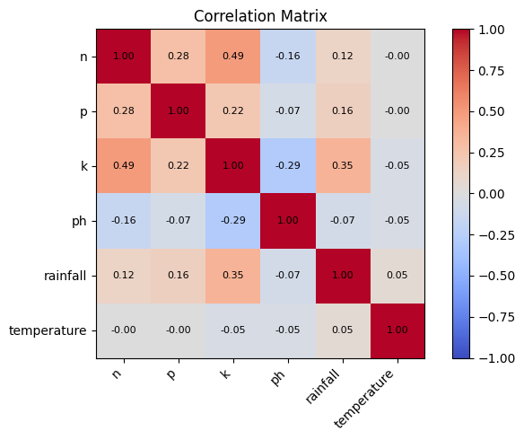
EDA: Correlation Heatmap (Actual)

Slide 13
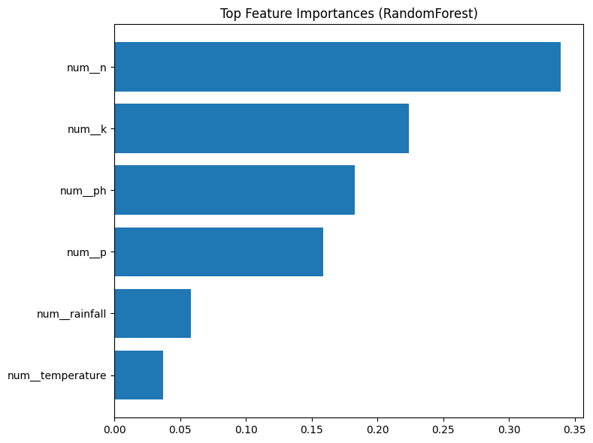
Model: Top Feature Importance(Random Forest)

Slide 14
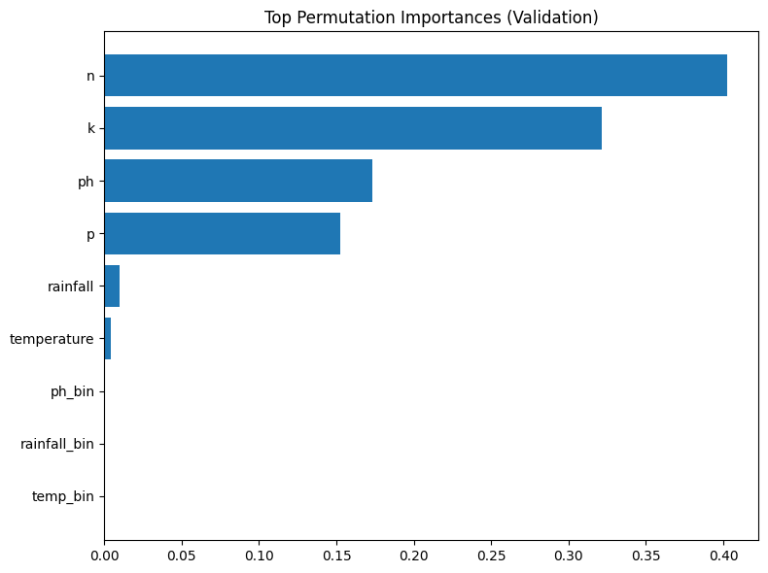
Model: Top Permutation Importance (Validation)

